Slide 1
FPGA-CPLD Based Designs
Vinay Sharma
vinay@ni2designs.com
ni logic Pvt. Ltd., Pune

Slide 2


Agenda
Electronic Systems, for we live
World of IC
Introduction to PLDs
  Working principles of CPLD & FPGA
Introduction to VHDL & its examples
PLD Design Flow
Comparison of CPLD/FPGA Architecture
Design Consideration for PLDs
Advantages of PLDs
Prototyping Solutions
Conclusion

Slide 3
Electronic System Our B & B
Communication Interface
Serial, parallel, high speed, USB, irDA, PCI
Digital Logic
FPGAs/CPLDs
Master
Microprocessor/Microcontroller
Memory
SRAM, FLASH, DRAM
Analog Circuitry
Sensors, Buffers, amplifiers, ADC, DAC
Power Electronics
SCRs, optical isolators,
relays, IGBT
Displays/Inputs
LCDs,LEDs

Slide 4

World of Integrated Circuits
Integrated Circuits
Full-Custom
ASICs
Semi-Custom
ASICs
User
Programmable
PLD
FPGA
PAL
PLA
PML
LUT
(Look-Up Table)
MUX
Gates

Slide 5
Programmable Logic
Since the invent of PLD from 1980s with few gate count, they have grown into million gates, so as there usage in different applications.
Advantages like programmability and reconfiguration of PLDs has given ideas and shape to many applications.
Todays PLDs like FPGAs can compete with ASICs in terms of performance and gate counts.
From the time their use has increased in all sectors, like defense, consumer, multi media, communications, DSP, etc.

Slide 6
What is Available ?
CPLD (Complex Programmable Logic Device) consists of multiple PLA blocks that are interconnected to realize larger digital systems.
FPGA (Field Programmable Gate Array) has narrower logic choices and more memory elements. LUT (Lookup Table) may replace actual logic gates.

Slide 7
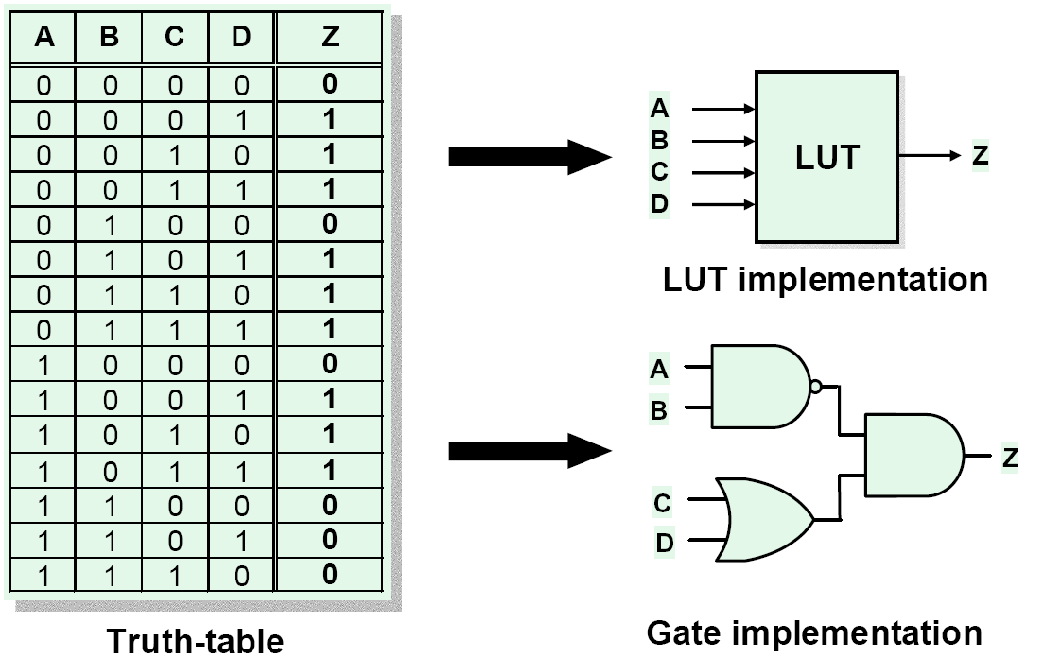
FPGA - Working Principle (LUT)
Look-up table with N-inputs can be used to implement any combinatorial function of N inputs
LUT is programmed with the truth-table

Slide 8
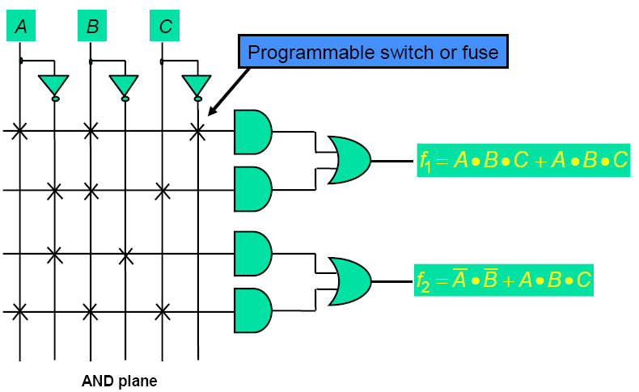
CPLD – Working Principle (SOP)
Programmable AND array followed by fixed fan-in OR gates

Slide 9
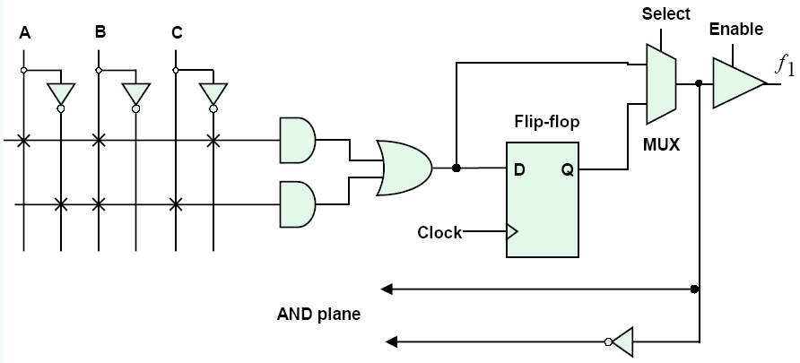
PLD - Macrocell

Slide 10
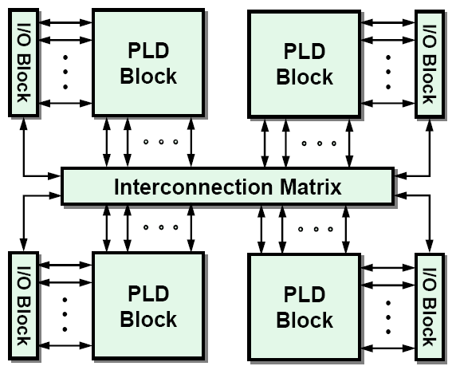
CPLD Architecture
Integration of several PLD blocks with a programmable interconnect on a single chip

Slide 11
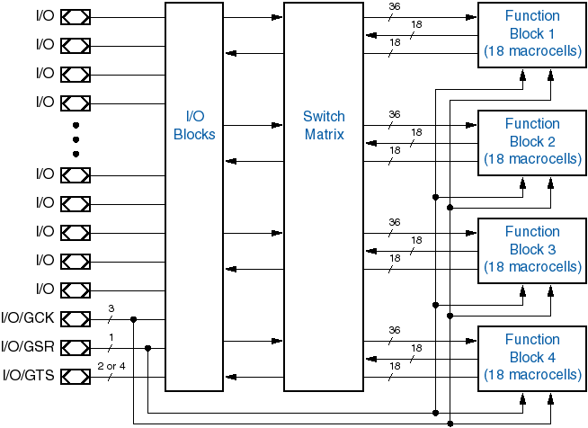
Xilinx 9500-family CPLD architecture
72 ==>
XC9572

Slide 12
Architecture Description
Each XC9500 device is a subsystem consisting of multiple
  Function Blocks (FBs)
    Provides programmable logic capability with 36 inputs and 18 outputs.
  I/O Blocks(IOBs)
    The IOBs provide buffering for device inputs and outputs.
  FastConnect switch matrix.
    Connects all FB outputs and inputs signals to the FB inputs.

Slide 13
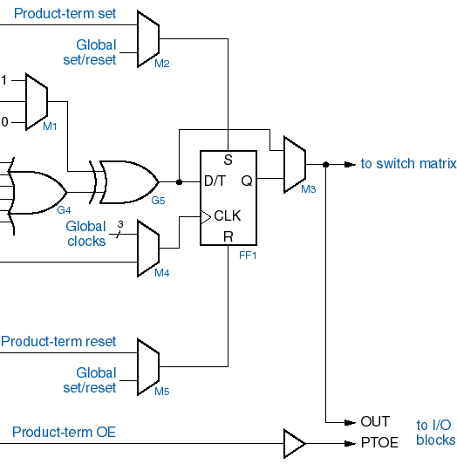
9500-series Macrocell (18 per FB)
Set control
Programmable
inversion or XOR
product term
Up to 5 product terms
Global clock or product-term clock
Reset control
OE control

Slide 14
Technology Used
CPLD’s are non-volatile devices, I.e retain the program after Power-off.
The EPROM, EEPROM, FastFlash are the non-volatile type of memory.
The FastFlash technology is used because of its advantage over the EEPROM.
  High Performance Logic Device.
  High Memory cell density
  Electrical erasable
  High reliability and endurance
  Fast device programming times

Slide 15
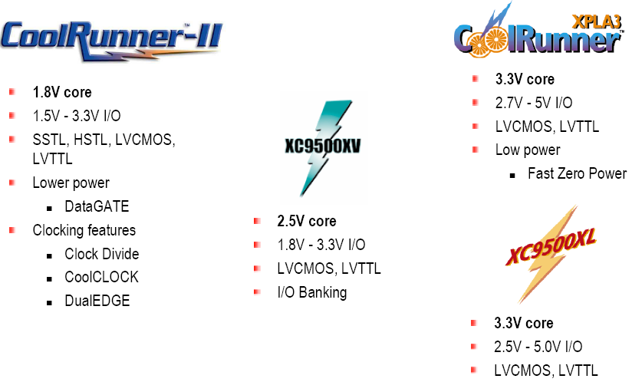
Xilinx CPLD Product Portfolio

Slide 16
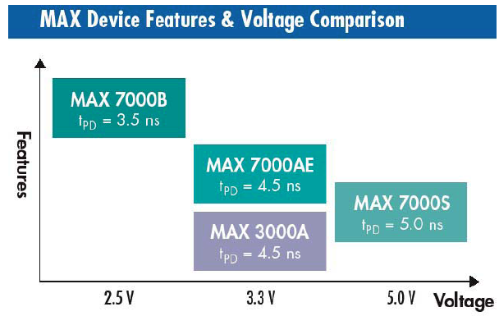
Altera CPLD Products

Slide 17
What is an FPGA ?
FPGA building blocks:
Programmable logic blocks
Implement combinatorial and sequential logic
Programmable interconnect
Wires to connect inputs and outputs to logic blocks
Programmable I/O blocks
Special logic blocks at the periphery of device for external connections
Logic block
Interconnection switches
I/O
I/O
I/O
I/O

Slide 18
Other FPGA Building Blocks
Clock distribution
Embedded memory blocks
Special purpose blocks:
  DSP blocks:
    Hardware multipliers, adders and registers
  Embedded microprocessors/microcontrollers
  High-speed serial transceivers

Slide 19
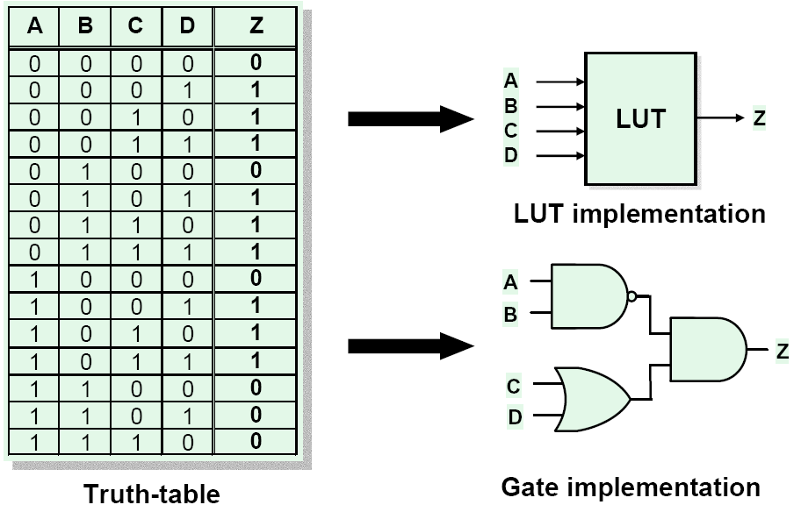
FPGA - Working Principle (LUT)
Look-up table with N-inputs can be used to implement any combinatorial function of N inputs
LUT is programmed with the truth-table

Slide 20
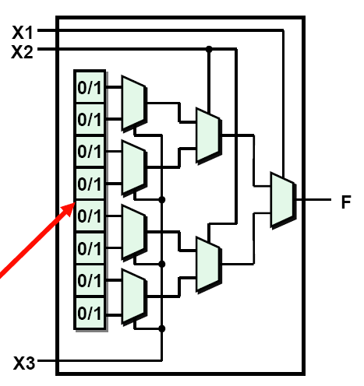
MUX based LUT
Example: 3-input LUT
Based on multiplexers (pass transistors)
LUT entries stored in configuration memory cells
Configuration Memory Cell

Slide 21
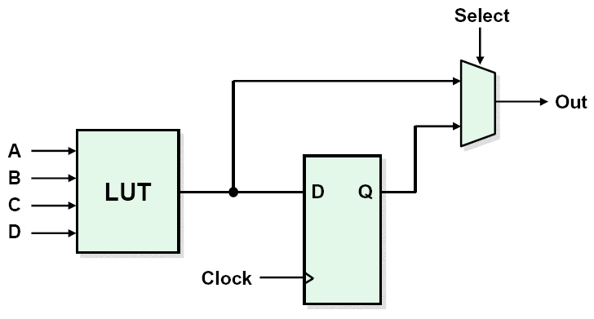
FPGA – Basic Logic Element
LUT to implement combinatorial logic
Register for sequential circuits
Additional logic (not shown):
  Carry logic for arithmetic functions
  Expansion logic for functions requiring more than 4 inputs

Slide 22


FPGA Vendors & Device Families
Xilinx
  Virtex-II/Virtex-4: Feature-packed high-performance SRAM-based FPGA
  Spartan 3: low-cost feature reduced version
  CoolRunner: CPLDs
Altera
  Stratix/Stratix-II
    High-performance SRAM-based FPGAs
  Cyclone/Cyclone-II
    Low-cost feature reduced version for cost-critical applications
  MAX3000/7000 CPLDs
  MAX-II: Flash-based CPLDs
Actel
  Anti-fuse based FPGAs
    Radiation tolerant
  Flash-based FPGAs
Lattice
  Flash-based FPGAs
  CPLDs (EEPROM)
QuickLogic
  ViaLink-based FPGAs

Slide 23







Xilinx FPGA Families
Old families
  XC3000, XC4000, XC5200
  Old 0.5µm, 0.35µm and 0.25µm technology. Not recommended for modern designs.
High-performance families
  Virtex (0.22µm)
  Virtex-E, Virtex-EM (0.18µm)
  Virtex-II, Virtex-II PRO (0.13µm)
  Virtex-4 (0.09µm)
  Virtex-5 (65nm)
Low Cost Family
  Spartan/XL – derived from XC4000
  Spartan-II – derived from Virtex
  Spartan-IIE – derived from Virtex-E
  Spartan-3 – derived from Virtex-II

Slide 24
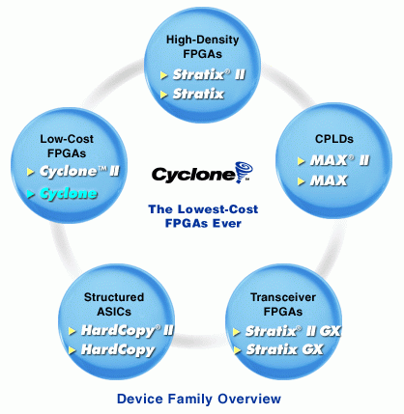
Altera FPGA Families
Old Families
  FLEX 10K, FLEX 6000, FLEX 8000
High-performance Families
  Mercury
  Stratix, Stratix GX, Stratix-II, Stratix-III, Stratix-IV
  APEX 20K , APEX II
  Excalibur
Low Cost Family
  Cyclone, Cyclone II

Slide 25
VHDL and its Examples

Slide 26
VHDL Language
Hardware Description Language (HDL)
  High-level language for to model, simulate, and synthesize digital circuits and systems.
VHDL = V_{HSIC}HDL.
  Very High Speed Integrated Circuit Hardware Descriptive Language.
History
  1980: US Department of Defense Very High Speed Integrated Circuit program (VHSIC)
  1987: Institute of Electrical and Electronics Engineers ratifies IEEE Standard 1076 (VHDL’87)
  1993: VHDL language was revised and updated
Verilog is the other major HDL
  Syntax similar to C language
Most tools accept both Verilog and VHDL

Slide 27
Terminology
Behavioral modeling
  Describes the functionality of a component/system
  For the purpose of simulation and synthesis
Structural modeling
  A component is described by the interconnection of lower level components/primitives
  For the purpose of synthesis and simulation
Synthesis
  Translating the HDL code into a circuit, which is then optimized
Register Transfer Level (RTL)
  Type of behavioral model used for instance for synthesis

Slide 28
Digital Circuits and VHDL Primitives
Most digital systems can be described based on a few basic circuit elements:
  Combinational Logic Gates:
    NOT, OR, AND
  Flip Flop
  Latch
  Tri-state Buffer
Each circuit primitive can be described in VHDL and used as the basis for describing more complex circuits.

Slide 29
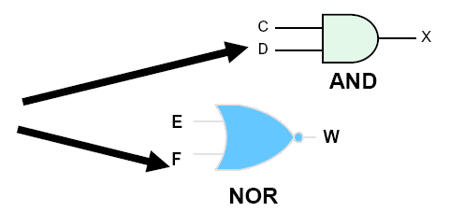
Digital Circuit Primitives
Combinational Logic Gates: NOT, OR, AND
Logic gates can be modeled using concurrent signal assignments:
  Z <= not A;
  Y <= A or B;
  X <= C and D;
  W <= E nor F;
  U <= B nand D;
  V <= C xor F;

Slide 30
4-to-1 Multiplexer
Library
library IEEE;
use IEEE.STD_LOGIC_1164.ALL;
entity mux is
port (
a, b, c, d: in std_logic;
s: in std_logic_vector(1 downto 0);
y: out std_logic);
end entity mux;
architecture mux1 of mux is
begin
process (a, b, c, d, s)
begin
  case s is
    when "00“ => y <= a;
    when "01" => y <= b;
    when "10" => y <= c;
    when "11" => y <= d;
  end case;
end process;
end architecture mux1;
External world interface
a
b
c
y
d
S1
S0
logic

Slide 31
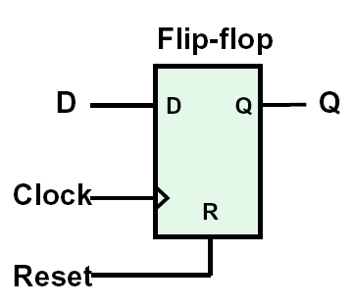
Sequential Logic: D-Flip Flop
architecture rtl of D_FF is
begin
process (Clock, Reset) is
begin
if Reset = ‘1’ then
Q <= ‘0’;
if rising_edge(Clock) then
Q <= D;
end if;
end process;
end architecture rtl;

Slide 32
PLD Design Flow

Slide 33
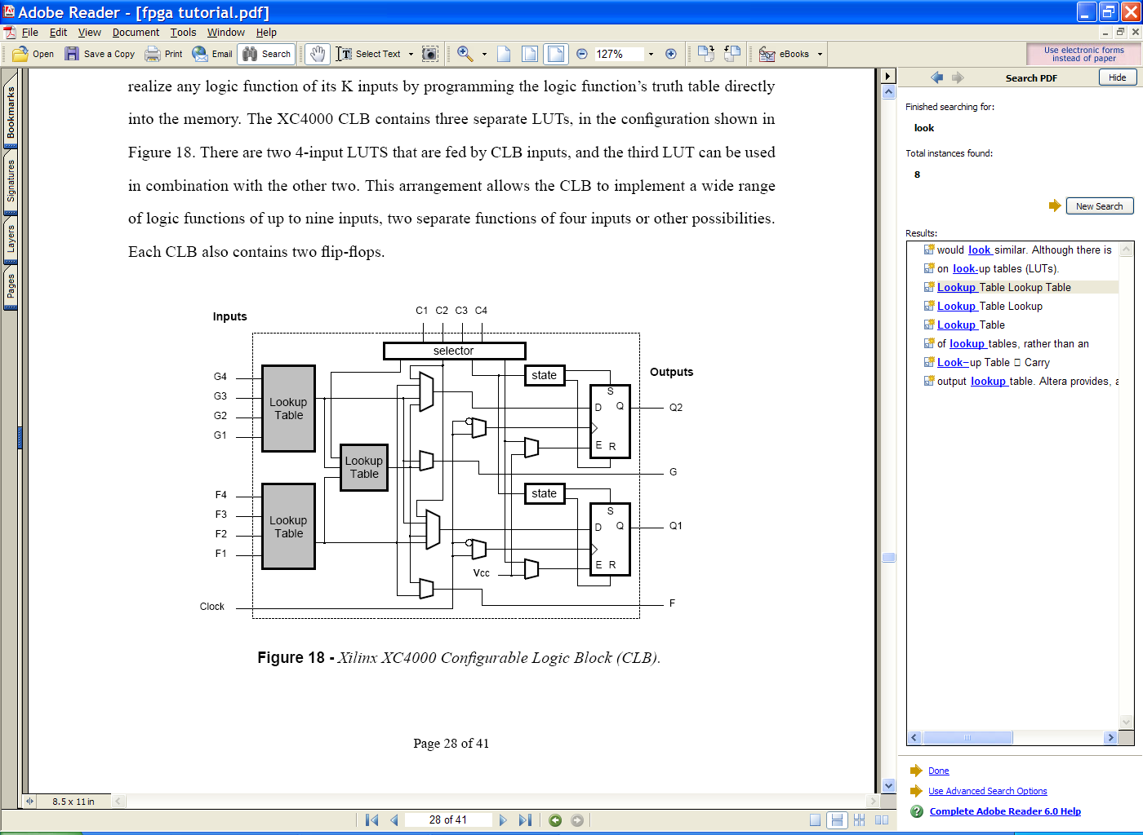
FPGA Design Flow
Design Specification
Design Entry/RTL Coding
Behavioral or Structural Description of Design
RTL Simulation
Functional Simulation
Verify Logic Model & Data Flow
(No Timing Delays)
LE
Synthesis
Translate Design into Device Specific Primitives
Optimization to Meet Required Area & Performance Constraints
MEM
I/O
Place & Route
Map Primitives to Specific Locations inside
Target Technology with Reference to Area &
Performance Constraints
Specify Routing Resources to Be Used

Slide 34
FPGA Design Flow
t_{clk}
Timing Analysis
- Verify Performance Specifications Were Met
- Static Timing Analysis
Gate Level Simulation
- Timing Simulation
- Verify Design Will Work in Target Technology
Program & Test
- Program & Test Device on Board

Slide 35

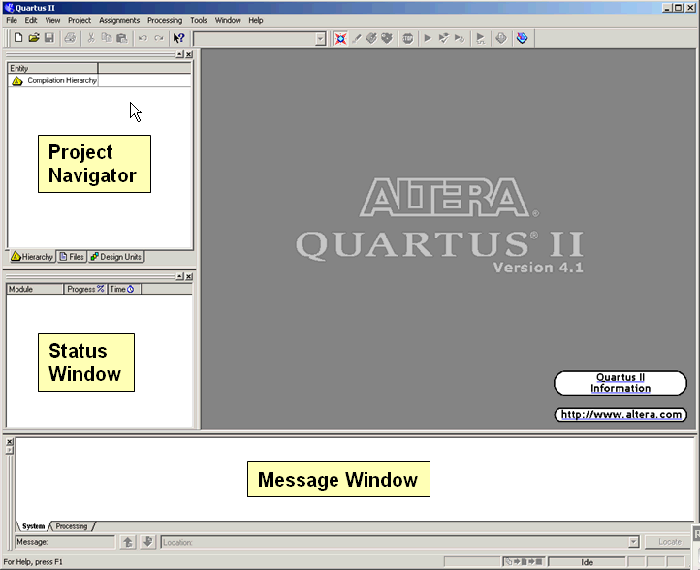
EDA Tools : Altera Quartus II
Fully integrated design tool
  Multiple design entry methods
    Text-based: VHDL, Verilog, AHDL
    Built-in schematics editor
  Logic synthesis
  Place & route
  Simulation
  Timing & power analysis
  Create netlist for timing simulation
  Device programming
Xilinx ISE has similar kind of features

Slide 36
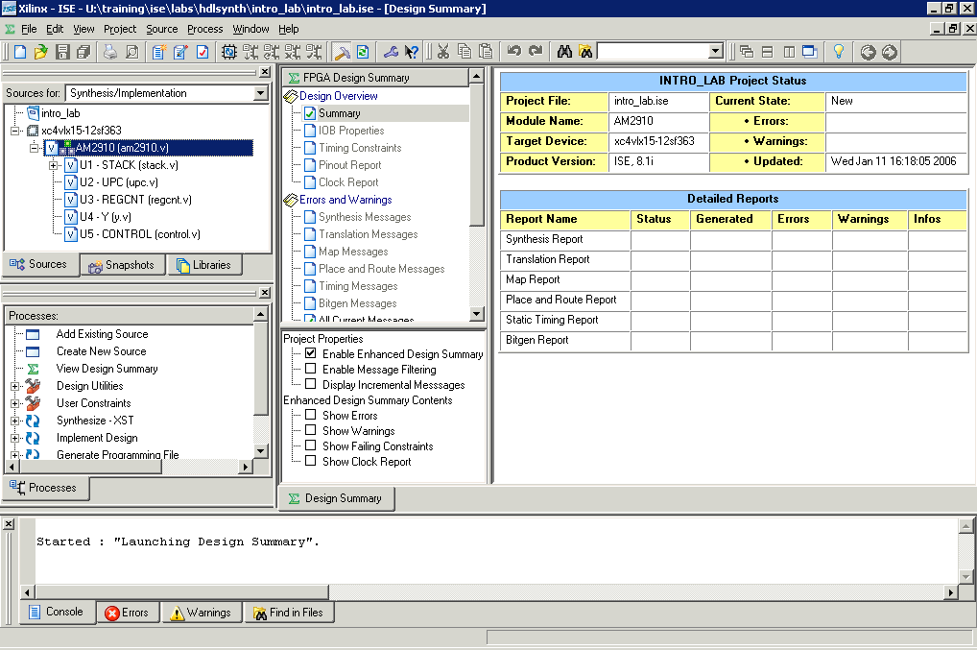
Xilinx - Project Navigator
Viewing Area
Sources
in project
Processes
for source
Message
Console

Slide 37
Comparison of CPLD / FPGA Architecture

Slide 38
CPLD Vs FPGA
Interconnect structure.
In-system performance.
Logic Utilization.
Applications.

Slide 39
Interconnect Structure
CPLD uses a Continuous interconnect structure :
  Consists of metal lines of uniform length traverse the entire length and width of the device.
  Since the resistances and capacitances of all interconnect paths is fixed, delays between any two logic cells can be predictable.
  This minimizes the logic skew.
FPGA uses a segmented interconnect structure.
  Consists of matrix of metal interconnects that run throughout the device. Switch matrices or Antifuses join the ends of these segments allowing signals to travel between logic cells.
  Number of segments required to interconnect signals is neither constant nor predictable, so delays are not fixed or specified until place and route is Completed.

Slide 40
Logic Utilization
Logic cells in most FPGA architecture have fine granularity, therefore more logic cells are required to implement a function in FPGA than in a CPLD.
Logic cells in FPGA can contain only small portion of a design, so a heavy burden is placed on its segmented interconnect structure.
As design complexity increases, the probability of routing conflicts also increases leading to lower FPGA device utilization.
Logic density in FPGA is less due to only 9 variables, where as CPLD has 36 variables available.

Slide 41
Applications - FPGAs
FPGAs
  Basically register intensive applications.
  Data paths.
  Hardware Emulation.
  Image controller.
  Battery powered applications.
  Field-test equipments.
  Gate-array prototyping.

Slide 42
Applications - CPLDs
CPLDs
  Basically combinatorial functions.
  Bus interfacings.
  Comparators.
  High-speed wide decoders.
  Large fast state micro controllers.
  High speed GLUE Logic.
  System video controller.
  PAL integration.

Slide 43
Design Consideration for PLDs

Slide 44
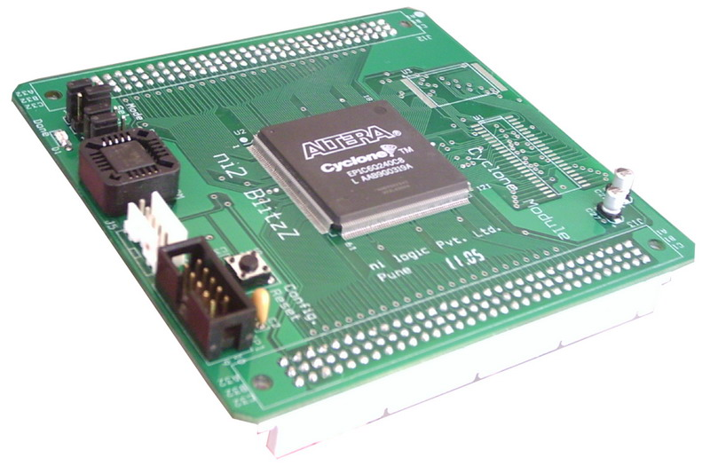
Designing with FPGA
A complete flat land (logic elements, memory, gates).
No predefined architecture or controllers.
Generation of timings and timing match.
Control of bus.
Handshaking of signals.
Protocol development.
Verification of logic.
User to describe complete logic with HDLs.
Logic dependant on ……..HDL…..HDL…..HDL……

Slide 45
Designing with FPGA
Microcontroller
Handshaking
FPGA
Memories
Timing
Analog Circuits
Voltage Levels
Communication
Protocols, Speed
Peripherals
Bus Control, triggering

Slide 46
Advantages of PLDs

Slide 47
Why to go for PLD’s ?
Flexibility.
In system programmability.
Less project development time.
Best prototyping solution.
Cost effective solutions.
Involves less risk.
Design security.
Consumes less board area.
Reconfigurable computing.
Best suits hardware verification for design.

Slide 48
Prototyping Solutions

Slide 49
Prototyping Solutions
“A system model to test and develop the product before its final implementation.”
Prototyping is like headache to designers
Ease of prototyping is necessity
Flexibility is must
Individual eval boards or kits available

Slide 50
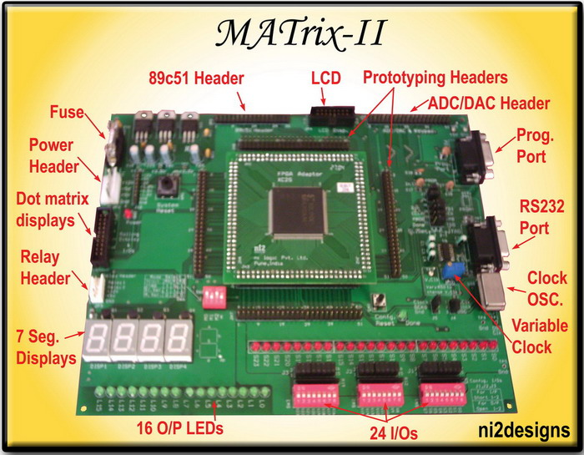
Prototyping Boards
Multi-vendor device support for Xilinx and Altera PLDs.
All FPGA I/Os accessible through headers.

Slide 51

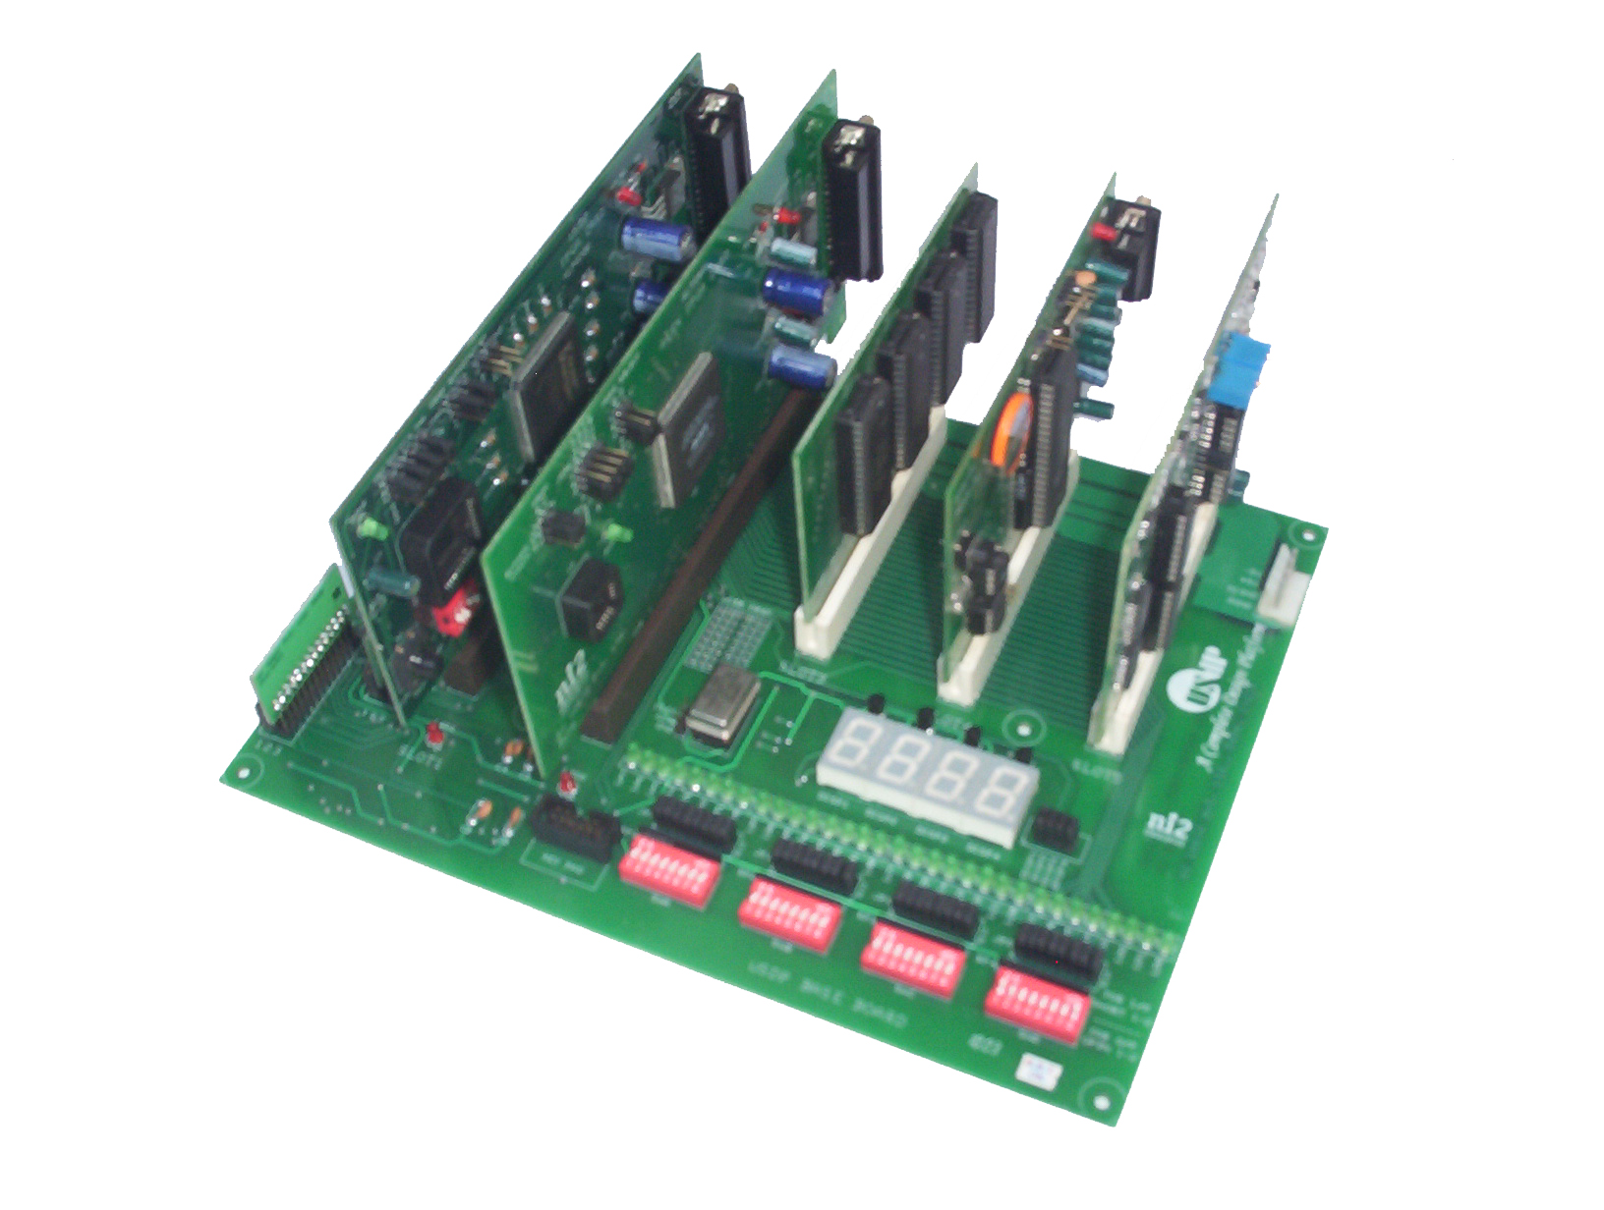
Prototyping Boards
A universal platform for various technologies
An excellent prototyping and system development platform
Modular approach
Modules can be integrated according to needs
Flexible and easy up gradation

Slide 52
Conclusion
PLDs have transformed the way product are designed today.
PLDs are now in our daily life.
Advantages and Applications of PLDs are endless.
VHDL & Verilog offers fast way of design and development.

Slide 53
Thank You..!
Vinay Sharma
vinay@ni2designs.com
ni logic Pvt. Ltd.,
21/22, Bandal Dhankude Plaza,
Opp. PMT Depo, Paud Road,
Kothrud, Pune – 411 038.
Maharashtra, India
Email: info@ni2designs.com
URL: www.ni2designs.com

